Slide 1
Heuristic Query Optimization

Slide 2
Query Processing and Optimization
Scanner: identify language components.
keywords, attribute, relation names
Parser : check query system
Validation: check attributes & relations
Query tree (query graph) : internal representation
Execution strategy: plan
Query optimization : choose a strategy
(reasonably efficient strategy)
16-1
18-<number>

Slide 3
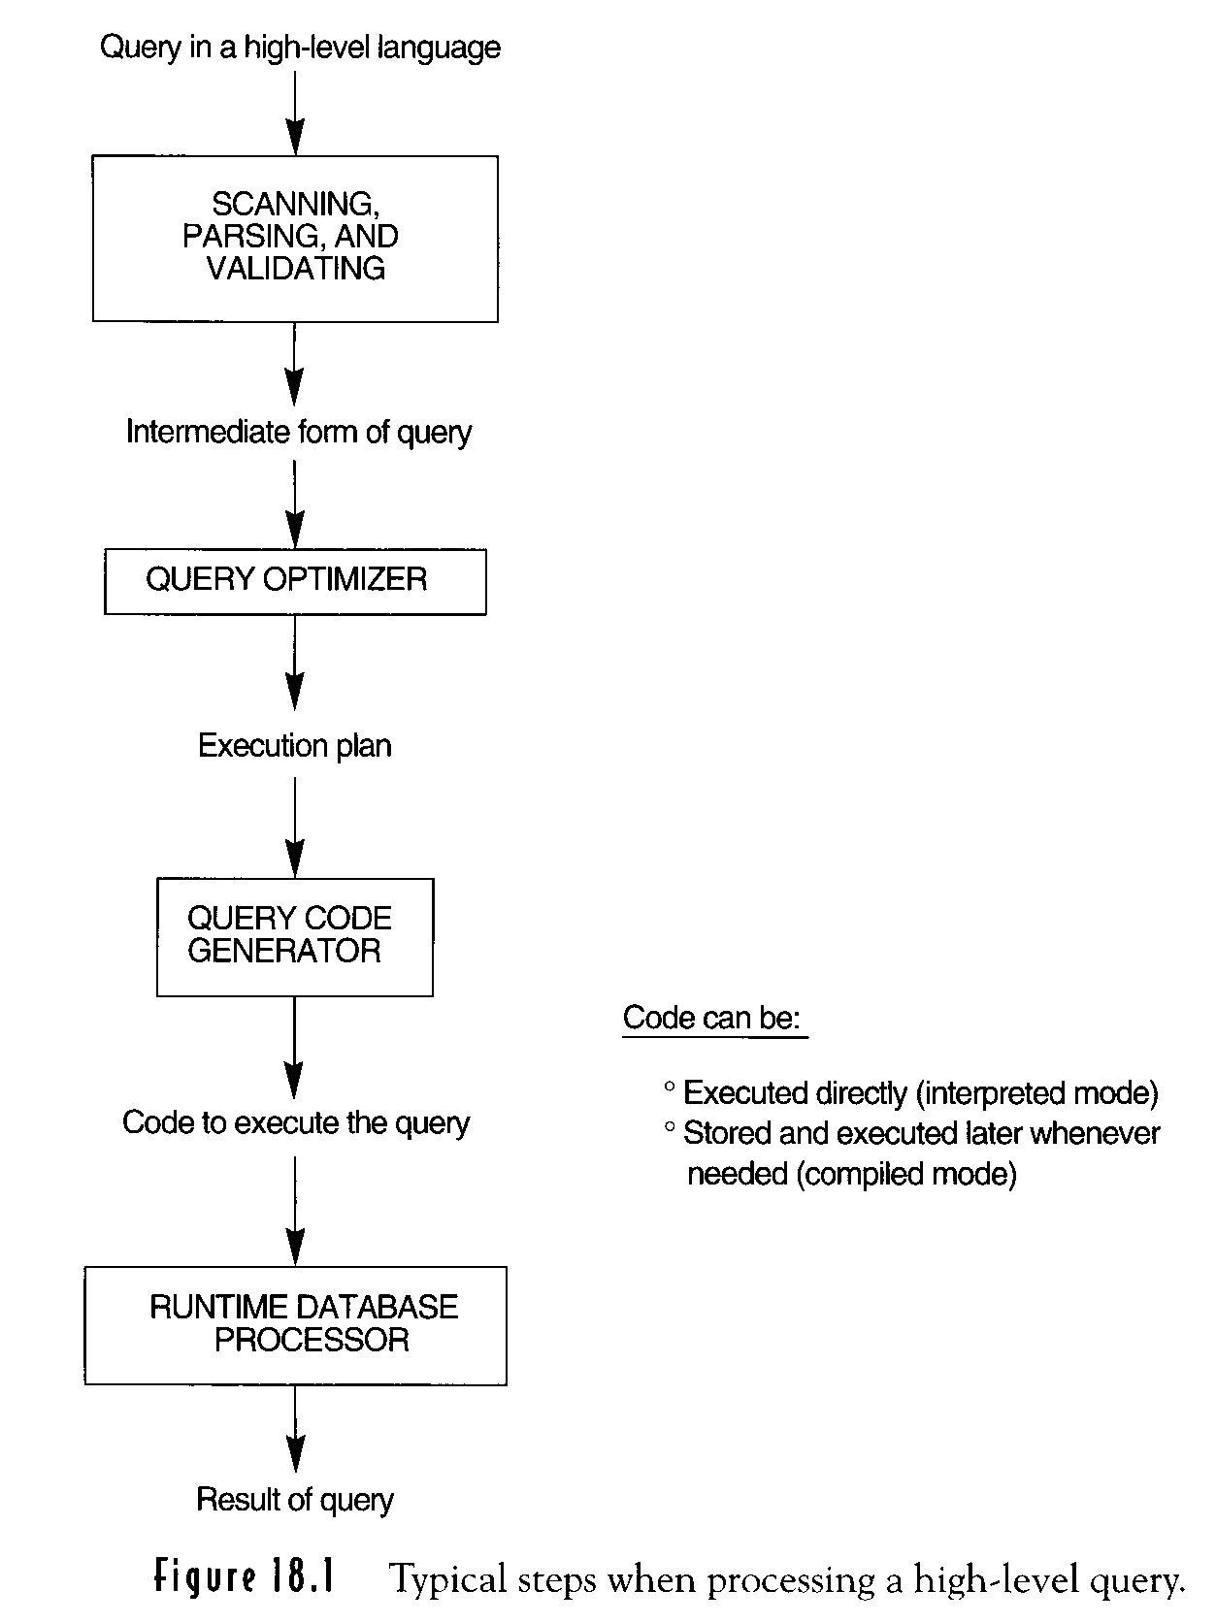
Figure 18.1 Typical steps when processing a high-level query
16-2
18-<number>

Slide 4
Heuristic Optimization of Query Trees
Query Tree (relational algebra expression)
leaf node :relations
Internal node :relational algebra operations
execution of query trees: post order traversal of tree
6-14
18-<number>

Slide 5
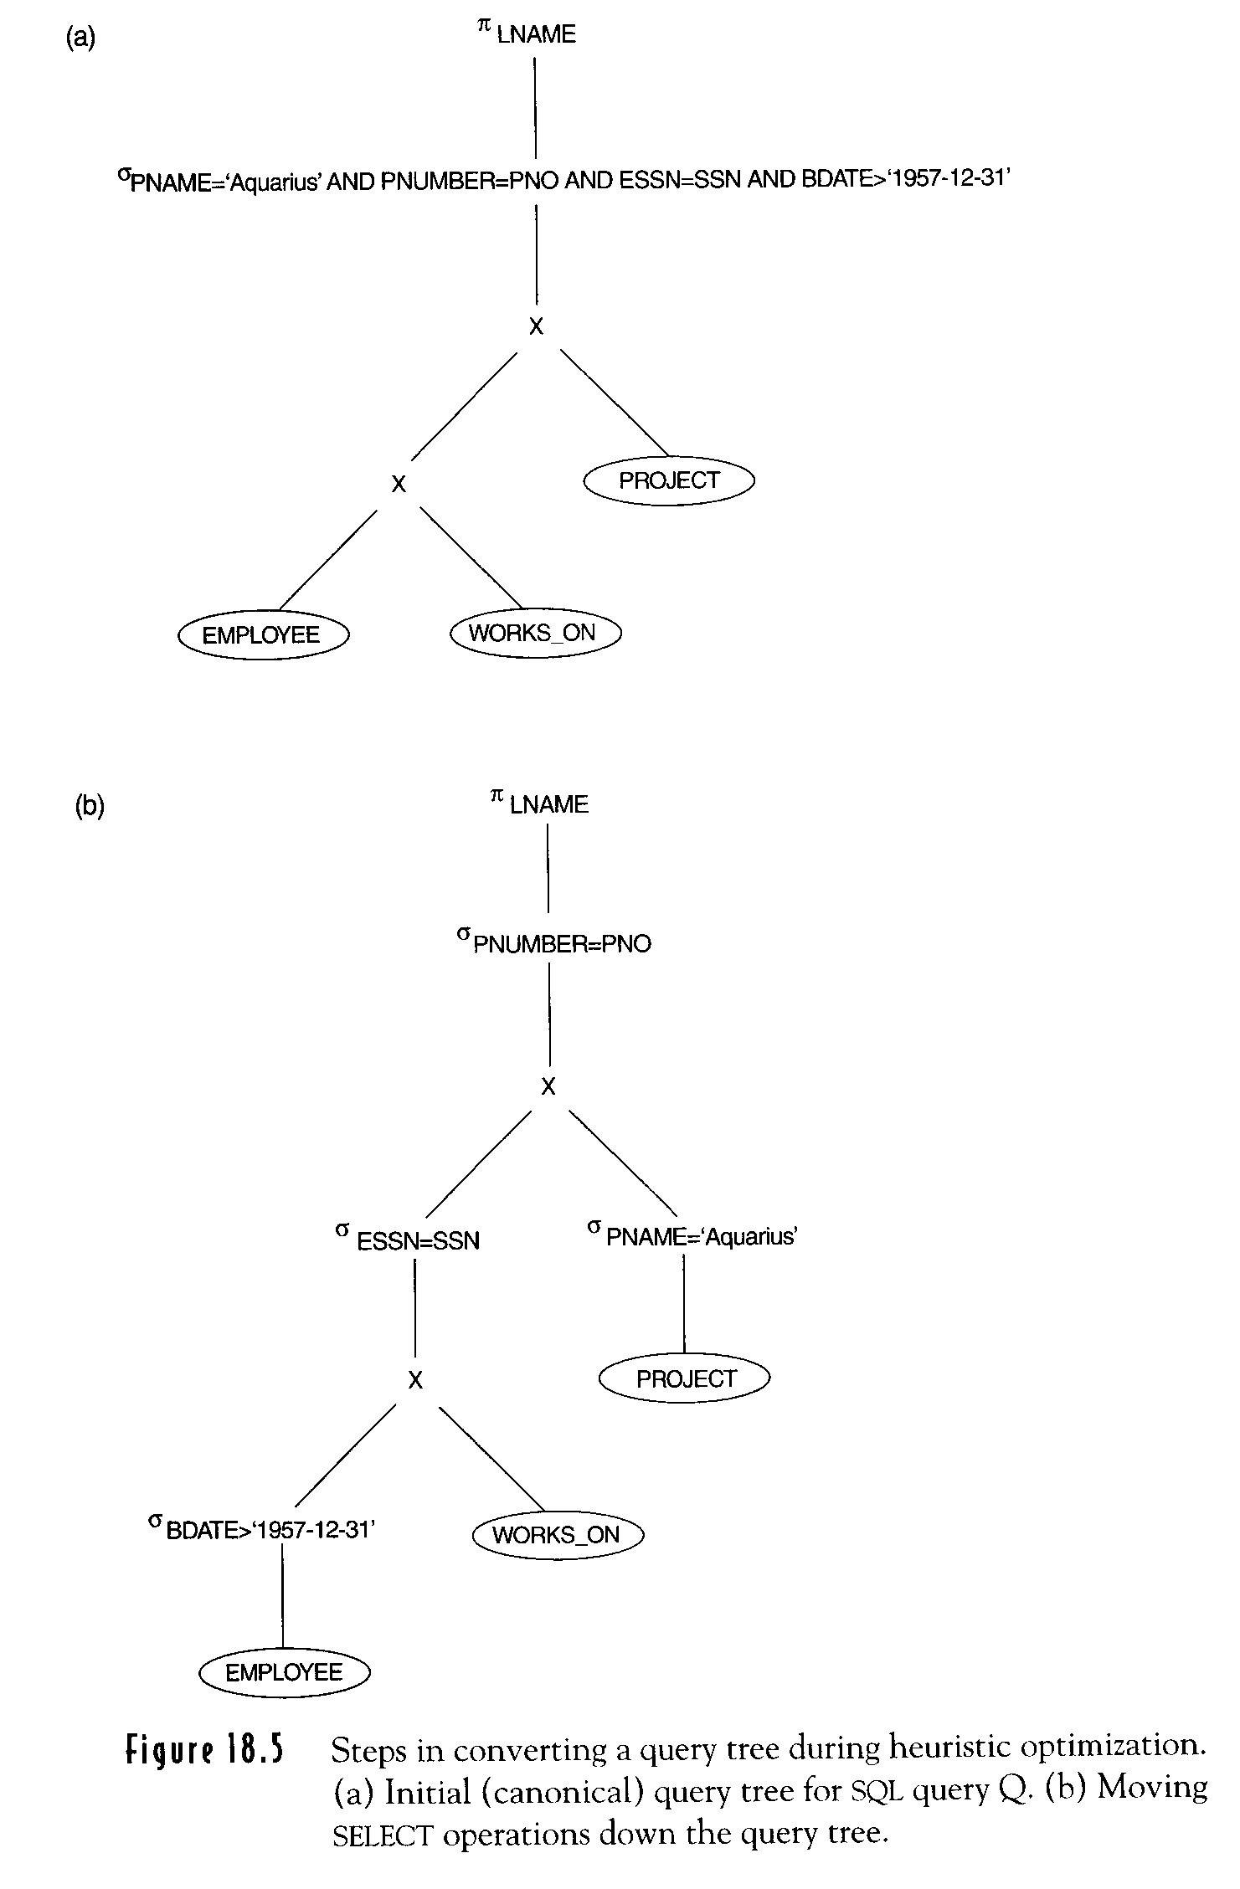
SELECT LNAME
FROM EMPLOYEE, WORKS_ON, PROJECT
WHERE PNAME=“Aquarius’ AND PNUMBER=PNO
AND ESSN=SSN AND BDATE > ‘DEC-31-1957’
Canonical query tree
6-16
18-<number>

Slide 6
Moving SELECT operations
down the query tree
6-16
18-<number>

Slide 7
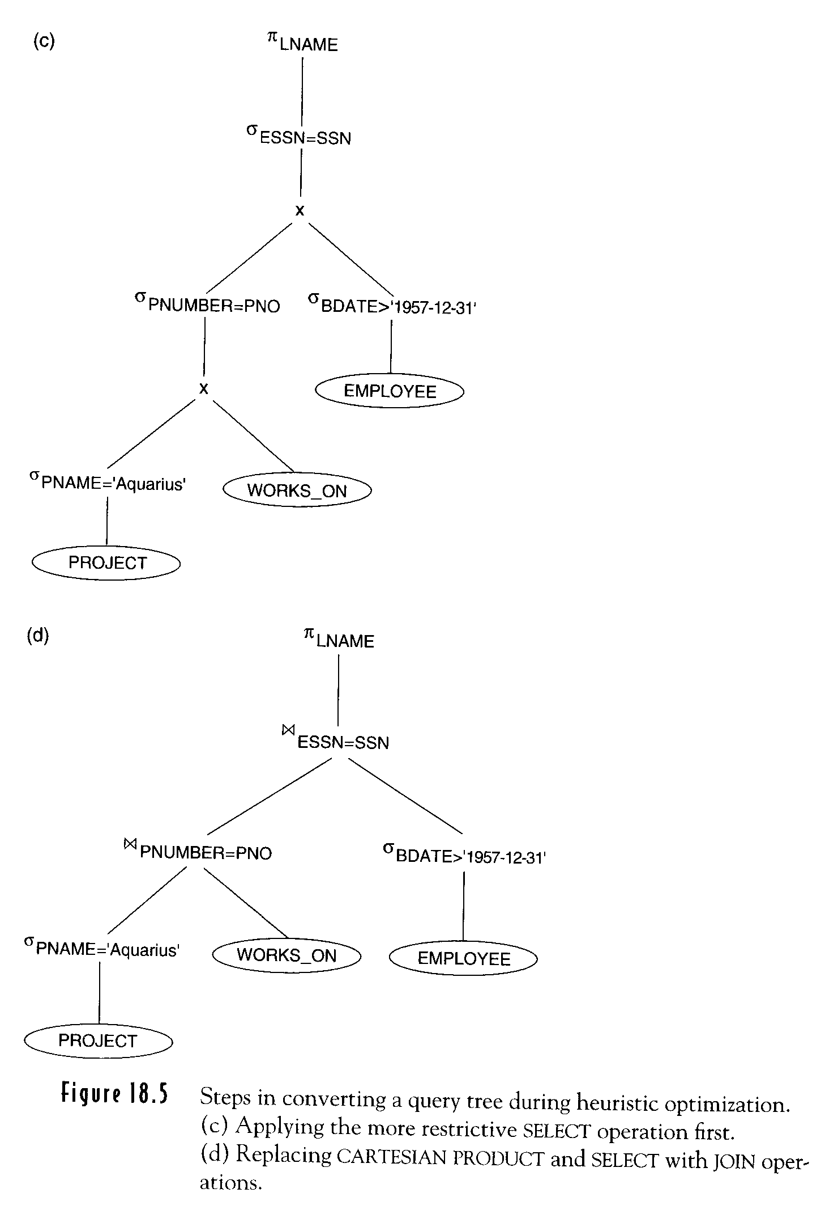
Figure 18.5(c) Applying more
restrictive SELECT operation first
SELECT LNAME
FROM EMPOYEE, WORKS_ON, PROJECT
WHERE PNAME=‘Aquarius’ AND
PUMBER=PNO AND
ESSN=SSN AND
BDATE > ‘DEC-31-1957’
6-17
18-<number>

Slide 8
Replacing CARTESIAN PRODUCT and SELECT with JOIN
6-17
18-<number>

Slide 9
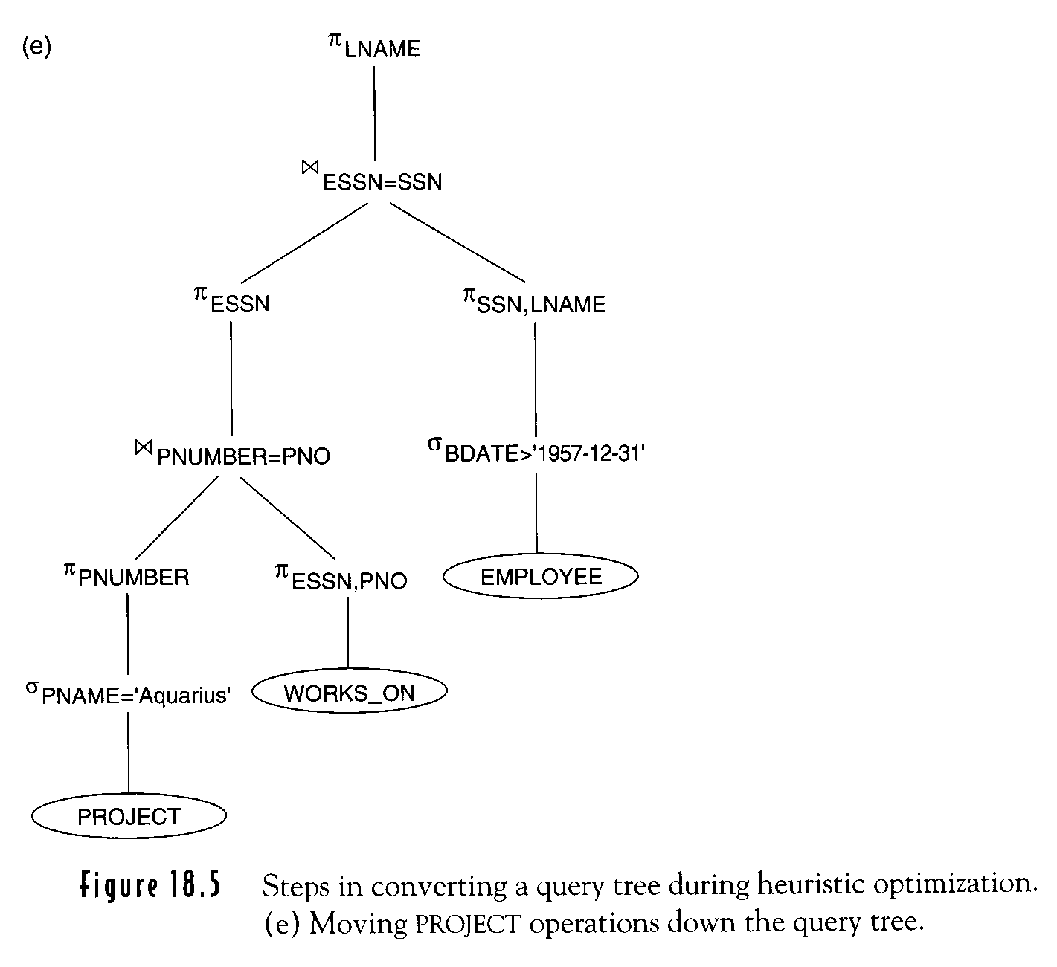
Moving PROJECT operations down
Transformation should keep equivalence
6-18
18-<number>

Slide 10
Outline of a Heuristic Algebra Optimization Algorithm
Break up any SELECT operations with conjunctive conditions into a cascade of SELECT operations.
σ_{C1 AND C2 AND …AND Cn}(R)≡σ_{C1} (σ_{C2} (…(σ_{Cn}(R))…))
Move each SELECT operations as far down the query tree as is permitted by the attributes
σ_{C1}(σ_{C2}(R)) ≡ σ_{C2}(σ_{C1}(R))
Π_{A1,A2…,An} (σ_{C} (R)) ≡ σ_{C} (Π_{A1,A2…,An} (R))
σ_{C} (R ⋈ S) ≡ (σ_{C} (R)) ⋈ S
σ_{C} (R  S) ≡ (σ_{C} (R))  (σ_{C} (S))
16-21
18-<number>

Slide 11
Outline of a Heuristic Algebra Optimization Algorithm (Cont.)
Rearrange the leaf nodes of tree so that the leaf node relations with the most restrictive operations are executed first.
(R  S) T ≡ R (ST)
Combine CARTESIAN PRODUCT with a sub sequent SELECT into a Join.
fewest tuples or smallest
absolute size
16-21
18-<number>

Slide 12
Outline of a Heuristic Algebra Optimization Algorithm (Cont.)
Break down and move lists of projection attributes down the tree as far as possible.
ΠList1 (ΠList2 (…(ΠListn (R))…))= ΠList1 (R)
ΠA1,A2…,An (σC (R)) ≡ σC (ΠA1,A2…,An (R))
ΠL (R ⋈ C S) ≡ (ΠA1,…,An (R))⋈ (ΠB1,…,Bm(S))
ΠL (R  S) ≡ (ΠL (R)) (ΠL (S))
Identify subtrees that represent groups of operations that can be executed by a single algorithm.
Π(σC1 (R)) ⋈ C2 (Π(σC3 (R)) ) see 6-18
16-22
18-<number>

